Slide 1
7
July
2022
Prepared & Presented by Shân Cade
Prepared & presented by Shân Cade

Slide 2
HS Codes Overview
1988
HS Code in Logistics. Export & Import shipping process with HS Code List_Chapter_Heading_Sub Heading.mp4

Slide 3
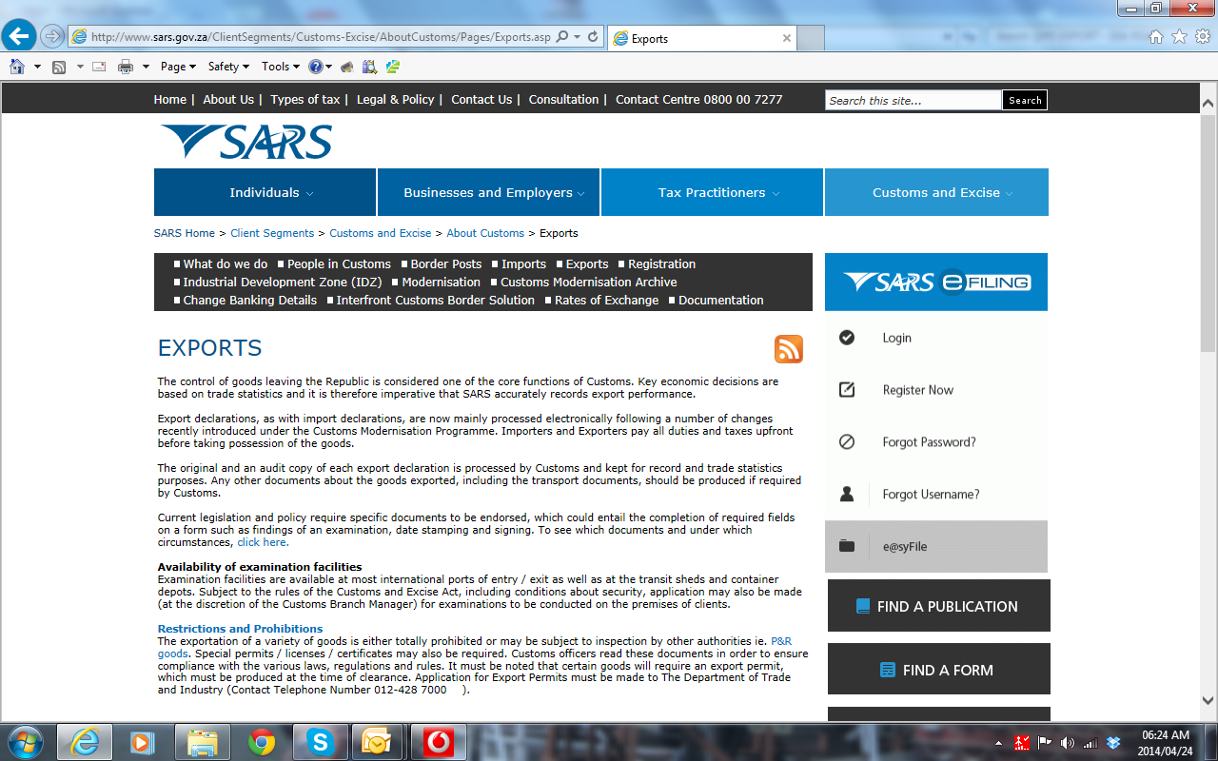
The Purpose of HS Codes
“surf” the SARS website
https://www.sars.gov.za/customs-and-excise/
Tariff
Classification

Slide 4
The Purpose of HS Codes
HS code system, was introduced in 1988 as a standardized numerical solution to classifying goods across the globe.
The HS code system was developed to simplify the calculation and implementation of taxes and duties, control regulated goods, monitor trade agreements, and collect trade statistics.

Slide 5
HS Challenges in the world
The sheer magnitude of globally traded items makes correctly classifying goods extremely complex
Complicating the current process is the lack of standardization between countries.
HS codes can vary between six and ten digits, depending on the country and their particular system.
Financial Risk

Slide 6
Benefits of the H S Code System
1.
It identifies products and attaches the correct duties and taxes
2.
It informs the customs officers about the nature of the goods, and provides insight into whether the shipped item is restricted.
3.
It facilitates official government bodies to collect, analyse, and compare trade statistics more efficiently.

Slide 7
What is the impact on the shipment if the HS Code is incorrect?
Fill in the squares

Slide 8
Whose responsible for classifying your products?

Slide 9
Difference between HS codes and HTS codes
Some countries add a further two to four digits.
Two examples of countries that do this are China and the USA.
These extended codes are referred to as Harmonized Tariff Schedule
codes or HTS codes
South Africa official tariff
Book is found on
www.sars.gov.za

Slide 10
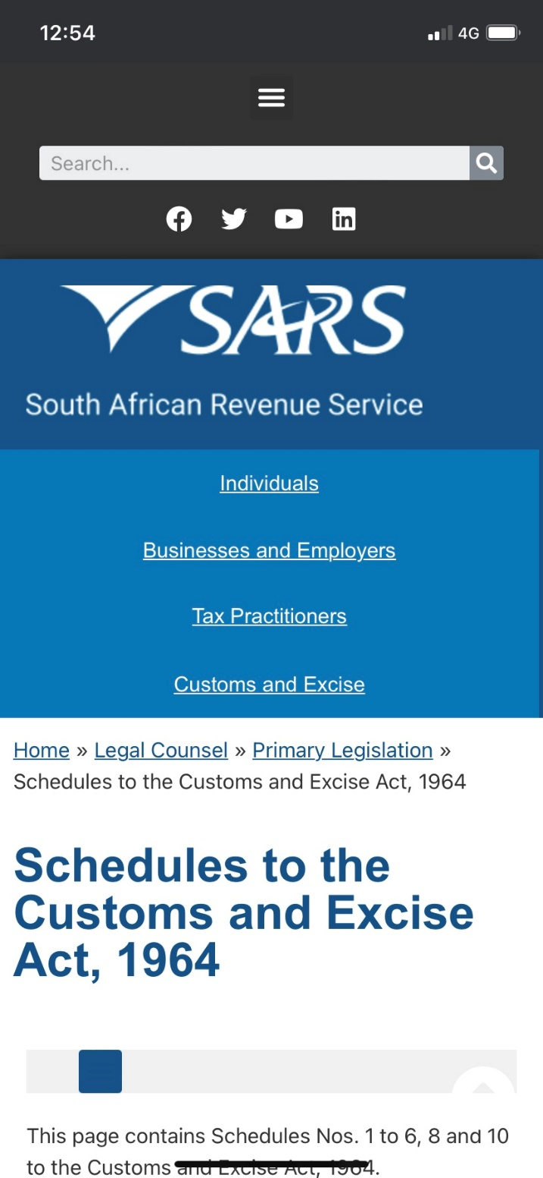
Where can you find HS Codes
https://tecex.com/the-complete-guide-to-hs-codes/
World Customs Organisation
Freight Forwarding Agent
Local Customs office
www.ftwonline.co.za
www.sars.gov.za

Slide 11
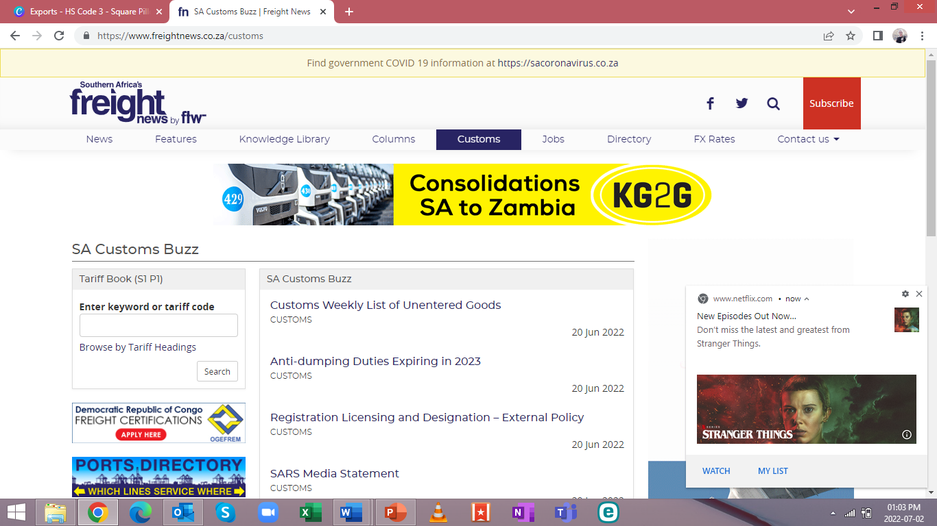

Slide 12
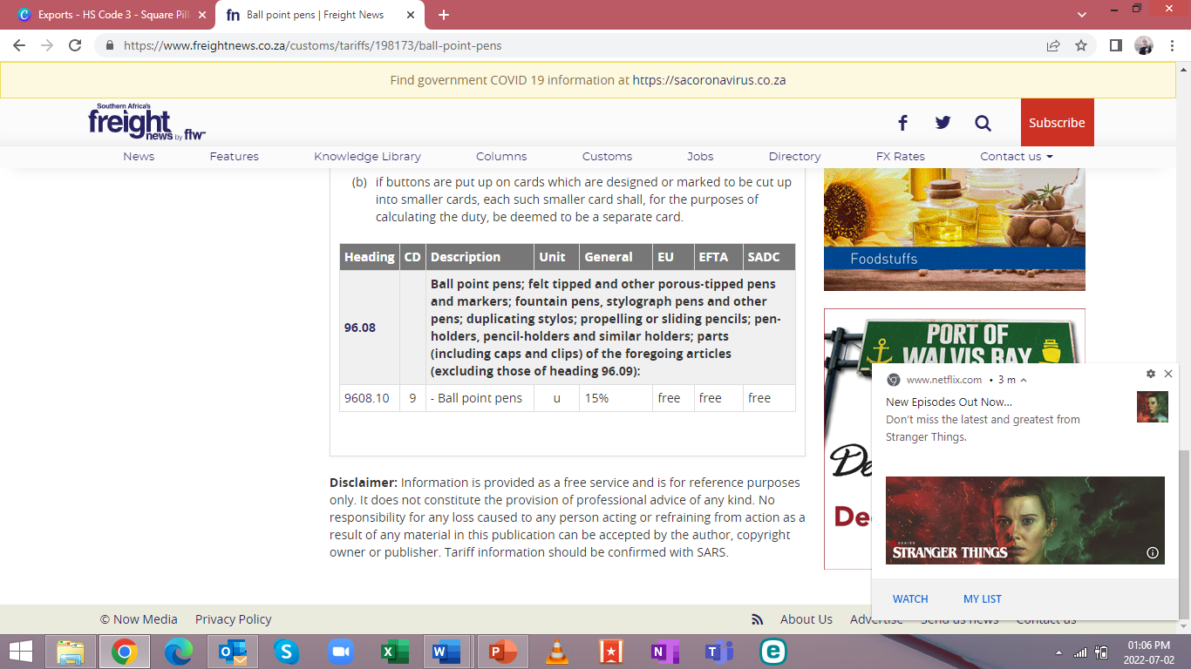

Slide 13
Search
www.sars.gov.za
and tariff your product.
If you have more
than one
product select
one only ☺

Slide 14
shan@shancade.com │+27 78 801 0896

