Slide 1








EXPORT
7 July 2022
Prepared & Presented by Shân Cade
Prepared & presented by Shân Cade

Slide 2
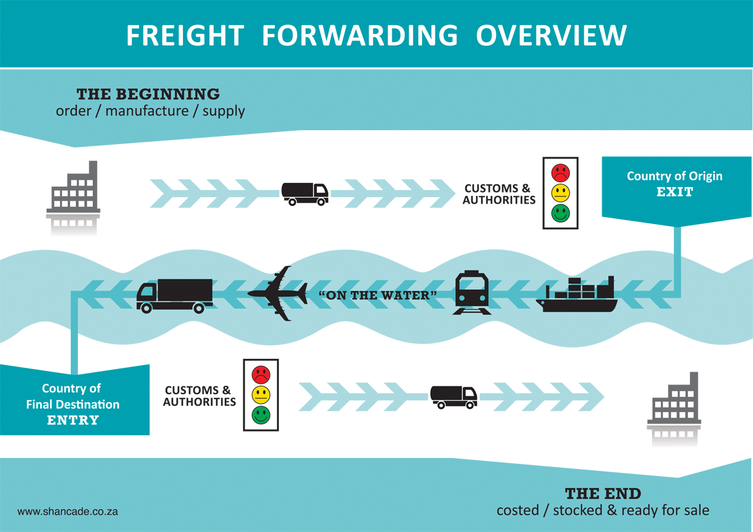
Export Cycle
Workbook page 9 - 11

Slide 3
Understanding the role-players
Seller
Buyer
Beneficiary
Bank
Beneficiary
Applicant
Shipper
Carrier
Consignee
Shipper
Insured
Insurer
Insured
Insured
Exporter
Customs
Exporter
Importer
Non resident
Country Monetary Control
Non resident
Resident
Start here
Workbook page 10

Slide 4

Shipping related formula
TOTAL DIMENSIONS:
ALWAYS calculate in meter form e.g. 150cm = 1.5m
MULTIPLY: Length X Width X Height = CBM
1 Meter = 100 cms
2. VOLUMETRIC WEIGHT:
1 CBM = 1 TONNE
ON BILL OF LADING:
4400 kgs = TARE of 40’
= Chargeable rate
AIR VOLUMETRIC WEIGHT
Length X Width X Height ÷ 6000
Air Freight is paid on the higher –
actual weight vs volumetric weight

Slide 5





Documentation control
Internally too
ALWAYS GET
SIGNATURES
FOR DOCUMENTS

Slide 6
Export Cycle
Enquiry / Quote
Export estimate from the agent
Order
Export planning template / file checklist
Control tools – production to finished product
Invoice
Product specific certification
Compliance docs - Govt requirements (SA & Foreign)
Inspection report (if applicable)
Insurance certificate

Slide 7
Export Cycle
Invoice
Packing list
Delivery note
Export Clearing instruction
Specific product related transport document
Workbook page 9 - 11

Slide 8
Export Cycle
Invoice
Packing list
Export Clearing instruction
SAD 500 customs control – exit S.A.
Transport document – e.g. Bill of Lading or Airwaybill
Specific product related transport document
Product specific compliance docs
Trade agreement documents e.g. Certificate of origin
Inspection report (if applicable)
Workbook page 9 - 11

Slide 9
Export Cycle
TOTAL Shipment Document pack
Considering all the countries the shipment may go through
Considering final country of import
Workbook page 9 - 11

Slide 10
Export Cycle
Invoice
Packing list
SAD500 customs control
Transport document – e.g. Bill of Lading or Airwaybill
Specific product related transport document
Product specific compliance docs
Trade agreement documents e.g. Certificate of origin
Inspection report (if applicable)
Import permit (if applicable)
Workbook page 9 - 11

Slide 11
Export Cycle
TOTAL import clearance batch
Internal transport specific (if applicable)
Workbook page 9 - 11

Slide 12
Export Cycle
TOTAL import clearance batch
Original transport documents
Workbook page 9 - 11

Slide 13




Quoting and Invoicing
These 2 documents need to be done CORRECTLY
Payment document
details e.g. L/C number
Workbook page 19 & 20

Slide 14

Quote – the purpose
Make sure ALL the information, calculations and compliant issues are covered, so that there is NO misunderstanding of who pays for what. when the risk changes hands and at what stage the product belongs to the buyer
Avoid any
type of

Slide 15
Quote contents
What When Where Which Who Why How How much
AGREED & SIGNED “ORDER” DOCUMENT NEEDED
RISK
&
COST
MANAGEMENT
Authorised Person

Slide 16

Question stage
What
When
Where
Which
Who
Why
How
How much
Workbook page 11

Slide 17

Export Quote
Customer requests a quote from you...
MAKE SURE you FULLY understand what they are wanting
Do your GROUNDWORK – aligned to an accurate check list
  Product costing – manufacturing / packaging / labelling / packing / dimensions / weight / compliance
  Freight forwarding costs – mode of transport / export clearance / freight / compliance
  Financial costs – credit guarantee / banking / FEC / LC
documents

Slide 18

Export Quote
Freight estimate - The FF Agent needs to know
The product details | Documentary Credit (if being used)
The transport details | Insurance requirements
Where its going to
Where its being collected
Who is paying for what
Dimensions
Weight – accurate
Any compliance issues
When it is expected to be shipped
The value of the cargo / currency
The customs tariff heading

Slide 19
Export Quote
YOUR quote to the customer requires
Full customer details | Documentary Credit requirements (if being used) OR payment terms and method of payment – bank details
The product details including packing/labelling | Documentation required
The transport details | Insurance details
Final destination details | The customs tariff heading
Collection details | Agent specific (if specified)
Who is paying for what (Incoterms 2020®) | The value of the cargo / currency
Dimensions / type of packing (e.g. Pallet) | When it is expected to be shipped (Lead Time)
Weight – accurate | Validity
Any compliance issues (their side too) | Signature & date
Follow-up receipt
convert to order

Slide 20

Quote contents
  Customer
  Full name
  Customer contact name
  Customer contact status/authority
  Customer email
  Customer phone numbers
  Customer country (ZIP code if applicable)
  Customer country regulation considerations e.g. prohibitions / import rules
  Customer delivery information / final destination / time
  INCOTERMS® 2020 to be used

Slide 21

Quote contents
  Name
  Product code
  Product description
  Product export price each / currency
  Product quantity each
  Product packaging quantity
  Product outer pack quantity/dimensions/weight
  Product labelling
  Product specific rules and regulations
  Product transportation considerations

Slide 22




Quote contents
  Transport
  Mode requested
  Transport regulations/compliance
  Transport packaging/packing
  Transport duration / environment
  SARS customs compliant

Slide 23

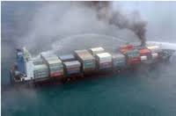

Quote contents
  Insurance
  FULL details
  Cover value
  Duration
  Specific to product
  Specific to compliance
  Exclusions

Slide 24
Quote contents
  Documentation requirements
  Signature control
  Aligned to Documentary credit
  Export instruction
  Customs Bill of Entry
HS Code
Quality control

Slide 25

Quote contents
  Agent details
  Company
  Contact name
  Contact email
  Contact phone/cell
  Agent in foreign country if needed
  EMERGENCY contact numbers

Slide 26
Quote contents
Payment details
  Value
  Trigger point
  Method – e.g. L/C details (if applicable)
  Banking details
  Control documents – Document batch
  Payment date / terms
  Penalty clause
It is ALL about the money

Slide 27

Customer Order
Always CHECK the order against the Quote or Pro-forma
Double check “lead times”
Handle differences
Quality control the final document
SIGN OFF is critical –
authorised person
Credit guarantee critical
Ask the same questions What, When, Where ..... DON’T take any chances
Workbook page 11

Slide 28

Estimate from the agent
It starts with COSTING
your product...
a BIG consideration
is the cost of shipping
So what does the agent need to know from you?
Cost of money

Slide 29

Export or Commercial Invoice
An IMPORTANT note to remember is that you can use an “export invoice” for shipping but it must correspond in values, information, VAT status, etc, to your “System TAX invoice” for VAT purposes and corporate financial control.
Some countries DO NOT allow an invoice that reads TAX INVOICE.
To zero rate
VAT = 0%

Slide 30

Export or Commercial invoice rules...
Quality control check EVERYTHING
Values
Currency
Quantities
Descriptions
special requirements
UCR
Product info
Transport Info
Compliance info
“DC” or payment information
Country specific requirements
(local & foreign)
Insurance

Slide 31

Export or Commercial invoice rules...
Manage time lines
Order ready date
Transport booking date
Stack date
Physical export date
Document movement dates
Payment date
Payment made date
Compliant documents in file date
Documentary Credit dates
EVERYTHING

Slide 32

Unique Consignment Reference number
The following few slide are from the SARB
presentation info pages

Slide 33
UCR Information
Created by the exporter / his agent.
Created for every export consignment.
Minimum length 12 & maximum 21 digits.
Is alpha-numeric and must not contain any special characters i.e., “/, \, -, *,”).

Slide 34
UCR Information
1st digit = last digit of the year of the export
i.e., ‘5’ for 2005.
Next 2 digits = the SWIFT code of the country of export ,
i.e. ‘ZA’ for South Africa.
Next 8 digits = CCN, ‘00011111’
Note! If the customs client code is less than 8 digits, then zeroes (0’s) must be added in front to make up 8 digits.
5 ZA 00011111

Slide 35
IT ADMINISTRATION
It is of the utmost importance to maintain an efficient IT system. Controlling emails in and out efficiently gets you out of trouble often.
Open an “in-box” folder for each customer. You can then data sort by date received / subject / person / conversation should queries arrive and you haven’t printed out a hard copy of the email.
Clean out your inbox / sent box / address book on a monthly basis – ONLY AFTER BACK-UP
Save to the cloud

Slide 36



Non-conformance management
..\..\..\..\Documents\1 - EDUCATIONAL MATERIAL\1. Posters - PDFS\Posters - March 2021\Poster 23 Non-Conformance process.pdf

Slide 37




Non-conformance register
..\..\..\..\Documents\1 - CLIENTS\1. Talk Lumber\NON CONFORMANCE\NON CONFORMANCE REGISTER - TALK LUMBER FEB 2015.xls

Slide 38
Non-conformance management benefits

Slide 39

Documents
Review for
your
product

Slide 40


shan@shancade.com │+27 78 801 0896

