Slide 1
SUSTAINABLE BUSINESS
Thinking
Prepared & presented by Shân Cade

Slide 2
ATTITUDE by Charles Swindol
“The longer I live, the more I realise the impact of attitude on life. Attitude to me is more important than facts.
It is more important than the past. Than education, than money, than circumstances, than failure, than successes, than what other people think or say or do. It is more important than appearance, giftedness, or skill. It will make or break a company… a church…a home.
The remarkable things is, we have a choice every day regarding the attitude we will embrace for that day. We cannot change the past. We cannot change the fact that people will act in a certain way. We cannot change the inevitable. The only thing we can do is play on the one string we have, and that is our attitude.
I am convinced that life is 10% what happens to me and 90% how I react to it. And so it is with you…. We are in charge of our ATTITUDES!”
Notes:
Attitude – the key to success

Slide 3
3 Critical Questions
Why do your staff want a job?
Why do your staff have a job?
How do your staff keep their job?

Slide 4
The work family
Owner
Manager
Bookkeeper
Supervisor
Workers
Notes:
Know who fits in where
Page system

Slide 5
What is this?
Money IN
Sustainable
business
Money
OUT
Notes:
Consistency - money in bigger the money out

Slide 6
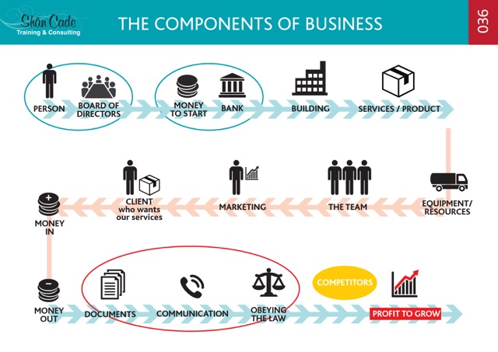
Notes:
Know the components of a business
Learn this chart well

Slide 7
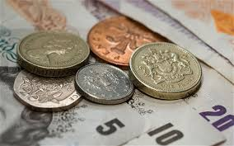
Owner/s
Owner
Suitable
safe
Cost effective
Budget
Cash-flow
Notes:
Owners are for the business

Slide 8
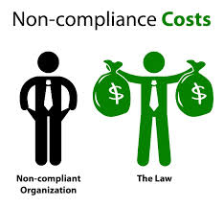
Owner/s
Owner
Notes:
NEVER get on the wrong side of the law

Slide 9
Without the owner/s there would be no Business
The owner/s responsibilities are VERY BIG . . . . Respect this
and
give them the support they need to make the business sustainable
Notes:
Respect yourself as a business owner or respect the owner
Ownership is a huge responsibility

Slide 10
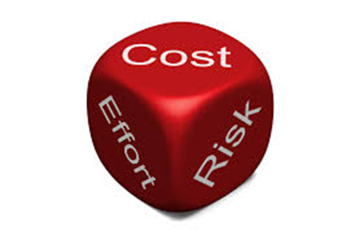
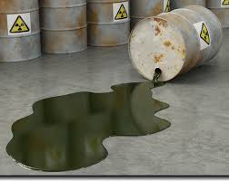
Management Team
Managers
Supervisors
Operations
Notes:
Managers role and responsibility align to the owners
Every component of the business must be managed effectively

Slide 11
They are the decision makers
Respect the POSITION

Slide 12
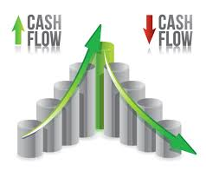
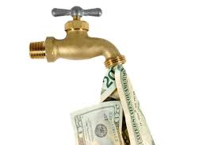
Money
Notes:
Getting the money in and money out balanced is critical
The business will struggle to survive if you don’t

Slide 13
Do YOUR part in controlling the money IN and money OUT
YOU will be respected
Notes:
It is everyone job to contribute to the sustainability of the business
How can you contribute as an employee / as an owner

Slide 14
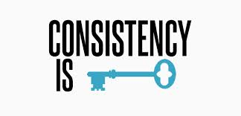
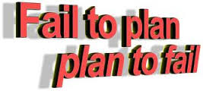
Workplace
This is YOUR workplace so look after it
Notes:
The workplace is a busy place – pay attention to detail in every way

Slide 15
Workplace
Plan to make time your partner not your opponent
Notes:
Time management is crucial to the success of the business
What components of business are affected by time?
Talk about some examples e.g. documentation vs penalties

Slide 16
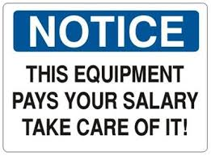
Equipment
Notes:
Resource management by everyone is not a choice thing – it is a have to
What are the benefits of managing and looking after the businesses resources?

Slide 17
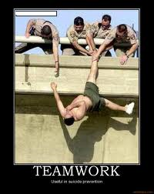
THE TEAM
Notes:
What does is mean to care?
What value is there to the business if everyone is a carer

Slide 18
THE TEAM needs to think sustainable business
Notes:
What happens to a business if everyone is not on the same page?

Slide 19
your
Notes:
What effects does not having a job have on your life?

Slide 20
Services / Product
?
What does the business sell?
Product needs to be UNIQUE
Product needs to be at a “GOOD” price
Product needs to be of a HIGH standard - CONSISTENTLY
Product needs to be BETTER than anyone else's
Notes:
Have a clear picture of every detail of your product or service in mind constantly
Continual improvement for the business and yourself is important for sustainability

Slide 21
Marketing & Sales
YOU are a constant advert for the business
Notes:
What’s the difference between sales and marketing?

Slide 22
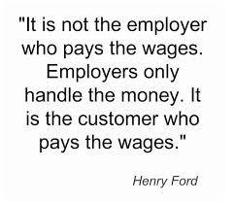
Customer service
Notes:
What kind of customer experience can you offer your customers?
Customer is king but can also be the downfall of the business
Need customers who pay on time / need what you have / fans of your product or service

Slide 23
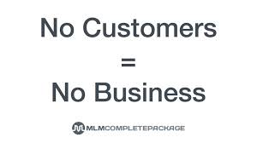
Customer service
NO BUSINESS – NO WORK
Notes:
The bottom line – no customer, no business

Slide 24
Communication
Communication = PASSING INFORMATION
Ensuring mutual understanding has been achieved
Notes:
Communication is the web that keeps EVERY component connected all the time
Give some examples of poor communication and the results of it

Slide 25
Competitors
You need to take your customers where your competitors have never been
Notes:
Trend watching is of high value to your business
Watch the competitors constantly
What things about your competitors should you be watching?

Slide 26
YOU win or lose by the way YOU choose, so decide to decide right
Think about and understand everything that happens in the business
Be valuable to the business
Notes:
Making the right choices will contribute to the sustainability of the organisation
It is everyone’s responsibility to make good choices all the time

Slide 27
R + 4C’s
Admin Rule
Activity
Notes:
Activity – Identify 3 risk areas within each business component

Slide 28
Critical Thinking
Activity
Notes:
Groups of 4 - Real life scenario – If looting happened again – using the method above – put the steps into place on how you would handle it effectively

Slide 29
Control Tools – the purpose
Policies | Emp. Contract | Job description | Focus Tool | Work Flow OR SOPS | Reminder System
Activity
See notes in pack for fuller details
Notes:
Draw-up an owners focus tool

Slide 30
Q & A
Notes:
Draw-up an owners focus tool

Slide 31
Shan@shancade.com
078 801 0896
@shancadetrainingandconsulting
Notes:
Follow us on social media
Like and comment
Support local

