Slide 1
The Purpose
of Control Tools

Slide 2
JOB DESCRIPTION | Government compliance Basic Conditions of Employment Act requirements Occupational Health & Safety Compliance Good corporate governance Individual understand of what they will be , doing Brings structure for continuity purposes Brings standardisation to individual job functions – no favouritism

Slide 3
FOCUS TOOL | Best practice aligned to good corporate governance Company risk, cost, consistency is management Ensures each individual concludes their daily job function Enables managers / supervisors to monitor workloads so that informed decisions can be made Ensures continuity of service can be achieved if someone is away or off for whatever reason Pro-actively monitors trends that affect sustainable business Manages weekly / monthly / quarterly / yearly activities Manages compliance – meeting deadlines, avoiding penalties Manages customer service levels

Slide 4
WORK FLOW | Best practice aligned to good corporate governance Enables a “quick overview” of the individual job function should someone have to step in Facilitates a “refresher” programme per job function An easy method of passing useful tips Enables more detail to be added for clarity Lays the foundation of any SOPS (Std operating procedures ) or WI (work instructions) when needed

Slide 5
REMINDER SYSTEM | Best practice aligned to good corporate governance Builds integrity Builds confidence Ensures deadlines are met Ensures compliance is achieved Professionalism Manages company risk & therefore cost Enables consistency within each job function Facilitates customer relationship building

Slide 6
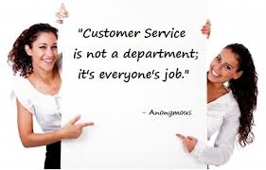
The RULES
USE the tools | Be disciplined | Be consistent | Be a team player | Build a sustainable business
Care about the company | Care about those who have to stand in for you | Give excellent customer service | Be a team supporter | Help the company to build a better life style for everyone

