Slide 1
Emotional Intelligence 101
Shari Cade- May 2017

Slide 2
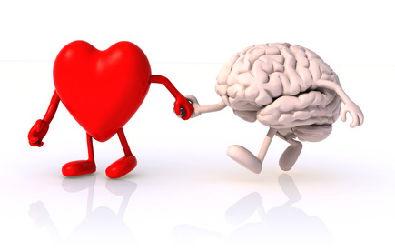
What is EI or EQ?
the capacity to be aware of, control, and express one's emotions, and to handle interpersonal relationships judiciously and empathetically.
"emotional intelligence is the key to both personal and professional success"

Slide 3
How Emotionally Intelligent are you?
Complete the emotional Intelligence “dipstick” to find out!

Slide 4
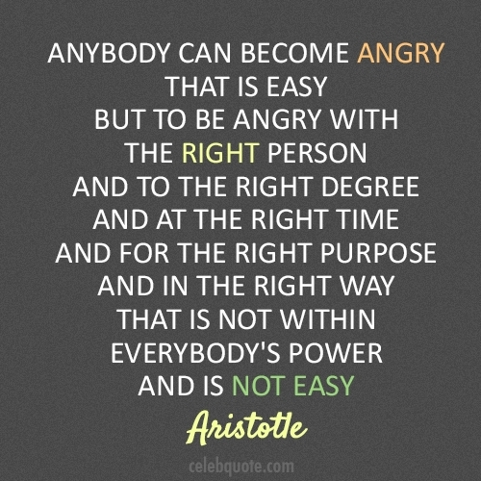
Emotions
Why is it important to recognise your emotions?
Why is it important to be able to think about what and how you feel?

Slide 5
How do our emotions work?

Slide 6
How do you feel today?

Slide 7
Emotions
What triggers your emotions?
What are your biggest triggers?
What is the difference between emotion, mood and temperament?
Are you able to identify emotions from non-verbal signs?

Slide 8
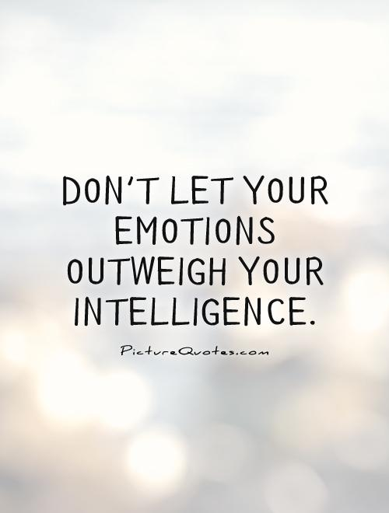
Emotions

Slide 9
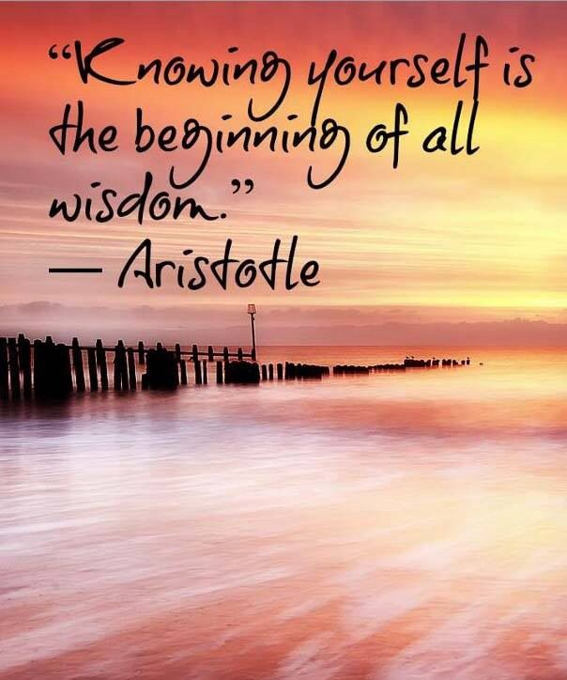
Intelligence
Think back to your last years at school, to your class mates:
Who were the ones you thought would make it?
What did you base your predictions on?
Who were the ones that you thought would be “drop outs”?
What did you base your predictions on?

Slide 10
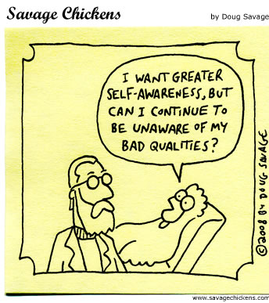
Intelligence
“… Analysis of more than 300 top-level executives from 15 global companies showed that emotional competency distinguished stars from the average: influence, team leadership, organisational awareness, self-confidence, the drive to achieve and leadership itself.” (Spencer and Chen)

Slide 11
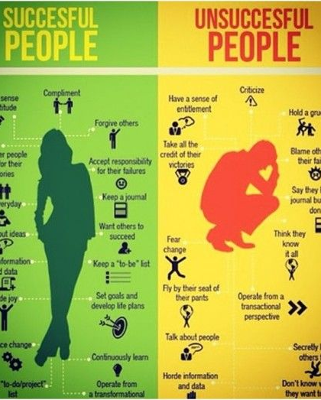
Multiple intelligence
Current research suggests there are multiple intelligences, not just one:
Verbal IQ
Non-verbal IQ
Artistic
Musical
Psycho-motor/technical
Personal effectiveness EQ
Interpersonal effectiveness EQ

Slide 12
“You can’t have good personal effectiveness without interpersonal effectiveness and vice versa.”
Personal Effectiveness | Interpersonal Effectiveness
Awareness of own emotions | Awareness of others’ emotions
Emotional expression | Valuing/sensitivity to diversity
Emotional control | Empathy/compassion
Managing mood | Listening to and reflecting feelings
Self-esteem and impact | Trusting and being trusted
Balance and wellness | Giving constructive feedback
Intentionality/vision | Generosity/abundance mentality
Resilience/perseverance | Staying calm under pressure
Flexibility/adaptability | Building relationships
Creativity and innovation | Developing others
Emotional Honesty/Integrity | Managing change

Slide 13
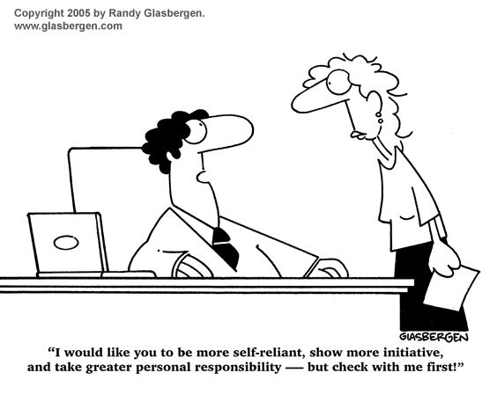
“Fortunately, scientists now consider EQ a learnable intelligence, one that can be developed and improved at any time and any age” (Goleman)

Slide 14
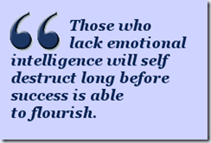
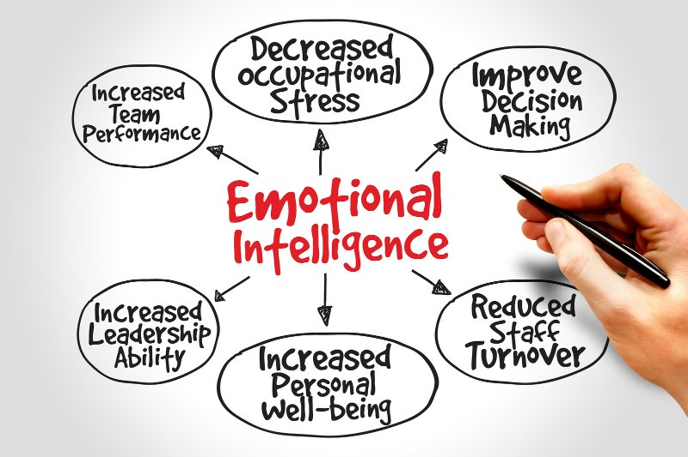
Applications of emotional intelligence:
How will becoming “more emotionally intelligent” impact on:
Yourself; Spouse/Partner; Children; Parents; In-Laws; Friends; Colleagues; Superiors; Subordinates; Competitors; Customers; Authorities.

Slide 15
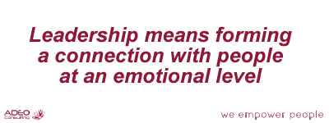
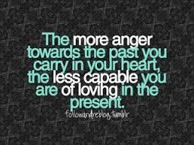
“Everything we do – or leave undone – makes a difference in this world”

Slide 16
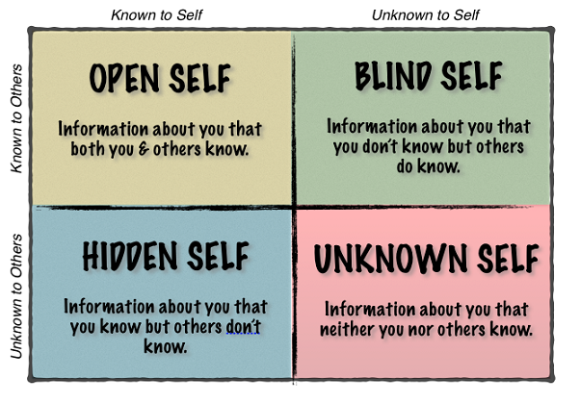
Knowing myself – “I need to be okay before we can be okay”

Slide 17
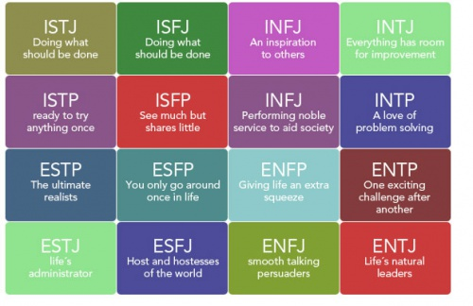
Myers Briggs personality test

Slide 18
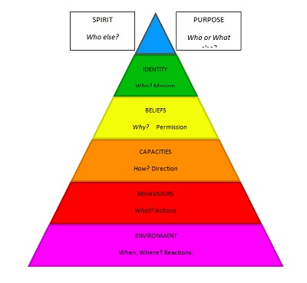
Exploring the core of who we are.

Slide 19
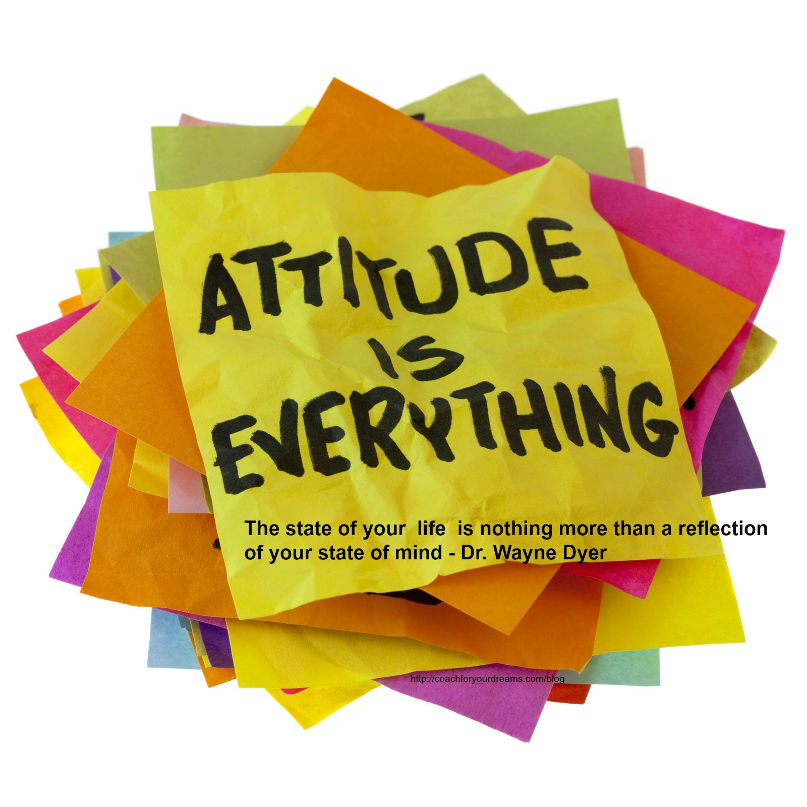
What determines our emotional responses?
Nature and Nurture:
Our genetic inheritance
Our brain functioning
Our life experiences
Our emotional thresholds or trigger points
Our expectations
How, when and if we express our emotions
How we make use of emotions to get what we want
Values
Beliefs
Perceptions
Self Esteem

Slide 20
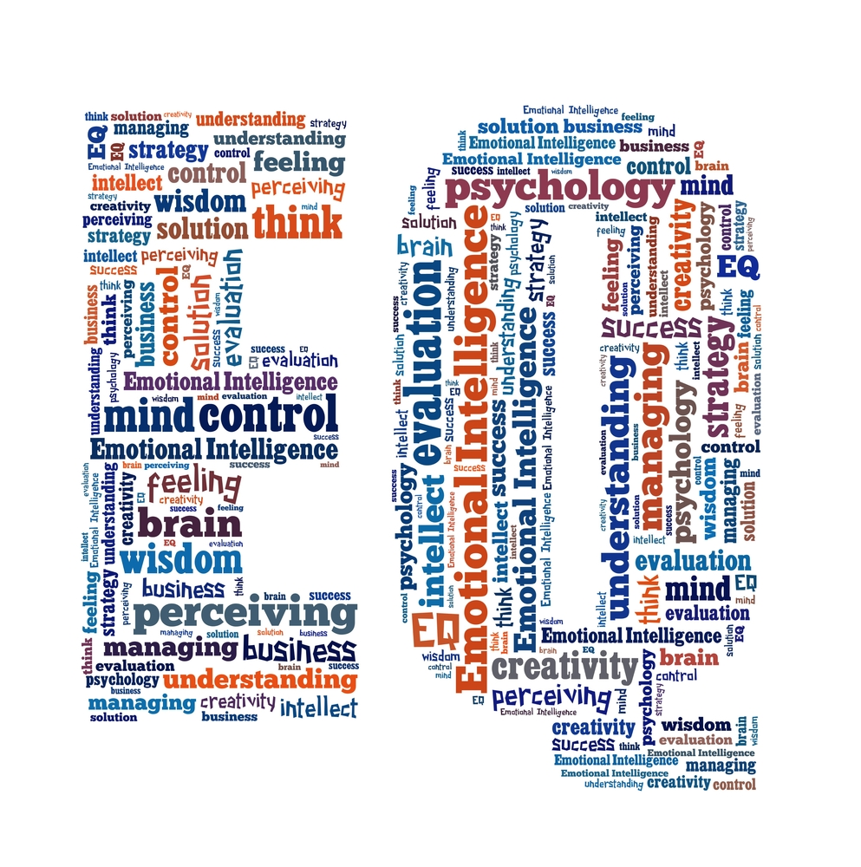
“The biggest discovery of my generation is that people can change their life by changing their thoughts” (William James)
Head on the pillow test – When you get into bed at night and put your head on the pillow, ask yourself: “I just traded 24 hours of my life for what I got today. Am I happy with the trade?”
If the answer is yes, congratulate and acknowledge yourself!
If the answer is no, ask yourself: ”What can I do differently tomorrow?”

Slide 21
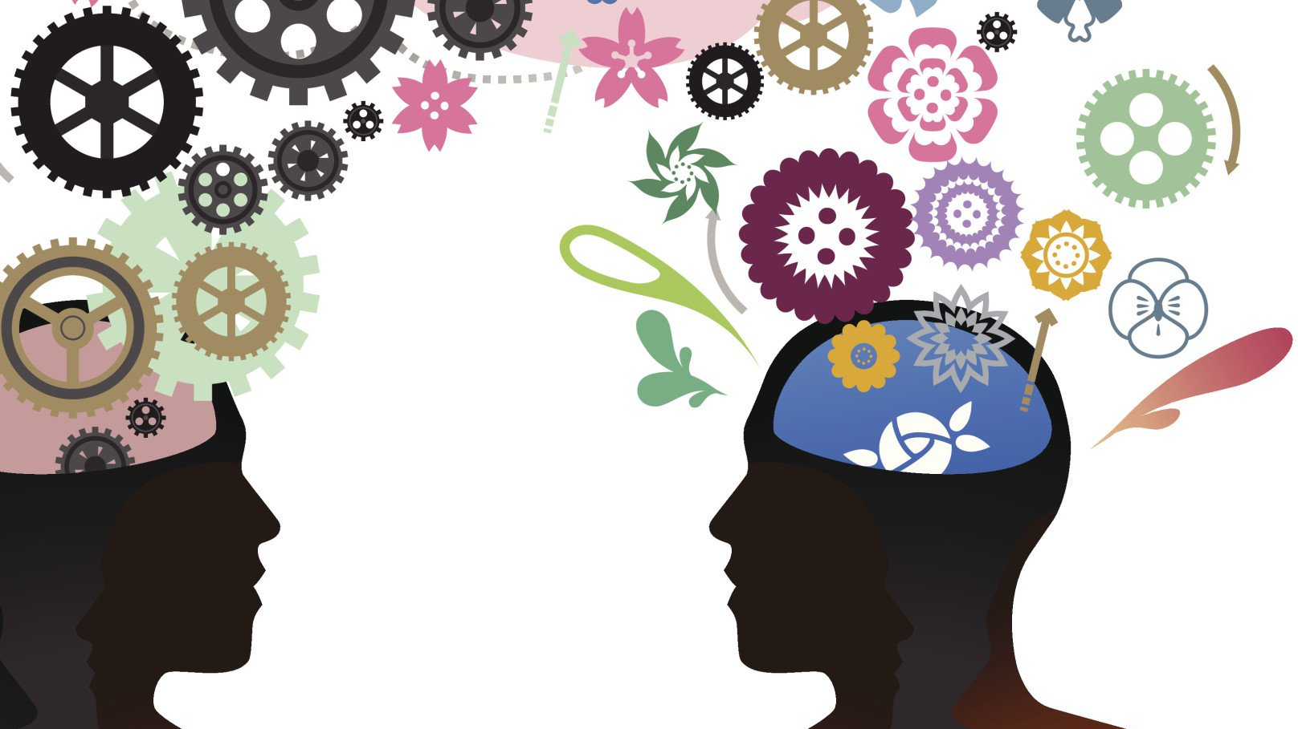
Managing my emotions:
12 Strategies to manage my emotions:
Identify your physical “Early warning signals”
Identify and change unwanted habits
Apply an Anger strategy
Follow the guidelines for dealing with emotions
Take charge of your thoughts
Reframe the problem
Get off the rescuer-victim-persecutor merry-go-round
Assert yourself without feeling guilty – use the magic word ‘no’
Call up a calm mental image
Manage your self-talk in emotionally challenging situations
Forgiveness
Deal with your hurt

Slide 22
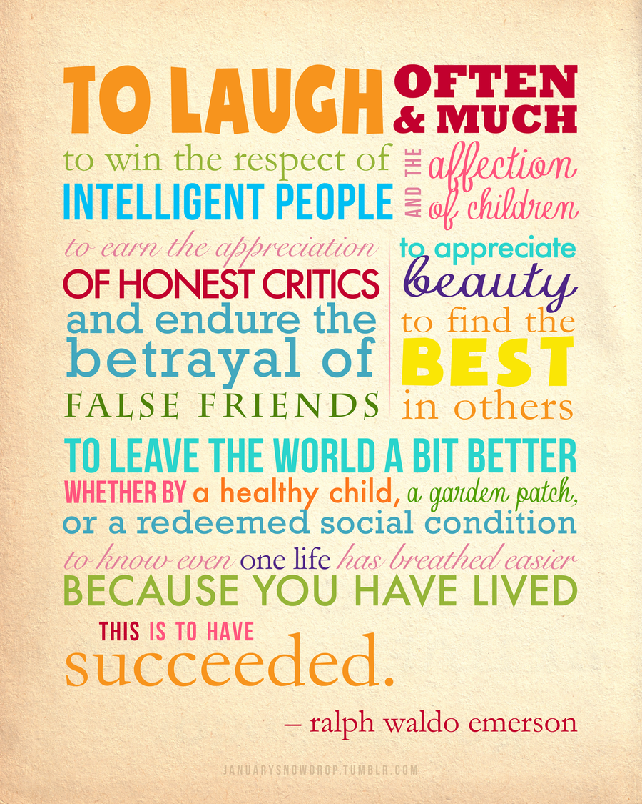
Achieving what I want
4 human fulfilment needs:
To Live (Physical)
To Love (Social/Emotional)
To Learn (Mental)
To Leave a Legacy (Spiritual)
What is your purpose in life? What is your unique contribution in life? What has changed, as a result of me having lived?, where am I leaving my footprints?, What legacy do I want to leave behind?

Slide 23
Thank you

